Slide 1
Automatic Planning (AI)
AI Planning
Explicit deliberation process that chooses and organizes action by anticipating their outcome.
Aims at achieving some pre-stated objectives.

Slide 2
Scientific goal of AI
Understand intelligence
Planning is an important component of rational (intelligent ) behaviour.
Engineering goal of AI
Build planning software for choosing and organizing action for autonomous intelligent mechanisms ( e.g. Robot).

Slide 3
Conceptual Model of Planning
Theoretical device for describing the elements of a problem
Plan
Action
Objectives
Actor
Time
Period
Resources
Evaluation
Criteria

Slide 4
Conceptual Model for Planning
State Transition Systems
A State transition system is a 4-Tuple
Ʃ - (S, A, E, ϒ )
S = { s1,s2,…….sn) - Set of states
A = { a1,a2,….. An} - Set of actions
E = (e1, e2,….en) - Set of events (not controlled by an agent)
ϒ = S x(AUE) → 2^{s}
If a ɛ A and ϒ (s,a) ǂØ then a is applicable in s
Applying a in s will take the state to s’ = ϒ (s,a)

Slide 5
High tech industries depend on AI planning and forecasting when developing cutting-edge technologies because human intuition is not well-suited for forecasting novel things but reliable planning is still essential to success.
Healthcare is rapidly adopting AI planning and forecasting to overcome the biases of doctors, researchers, and support staff to better understand illness and adapt treatments using data-driven approaches, saving lives and improving quality of living.

Slide 6
Missionaries and Cannibals Problem
In the missionaries and cannibals problem, three missionaries and three cannibals must cross a river using a boat which can carry at most two people, under the constraint that, for both banks, if there are missionaries present on the bank, they cannot be outnumbered by cannibals (if they were, the cannibals would eat the missionaries). The boat cannot cross the river by itself with no people on board.
Possible representation of states
Initial state : (3 , 3, 1) Goal state : (0,0,0)
Cost function - No of. boat rides
No. of Missionaries At the left bank | No . of cannibals At the left bank | boat at the Left bank

Slide 7
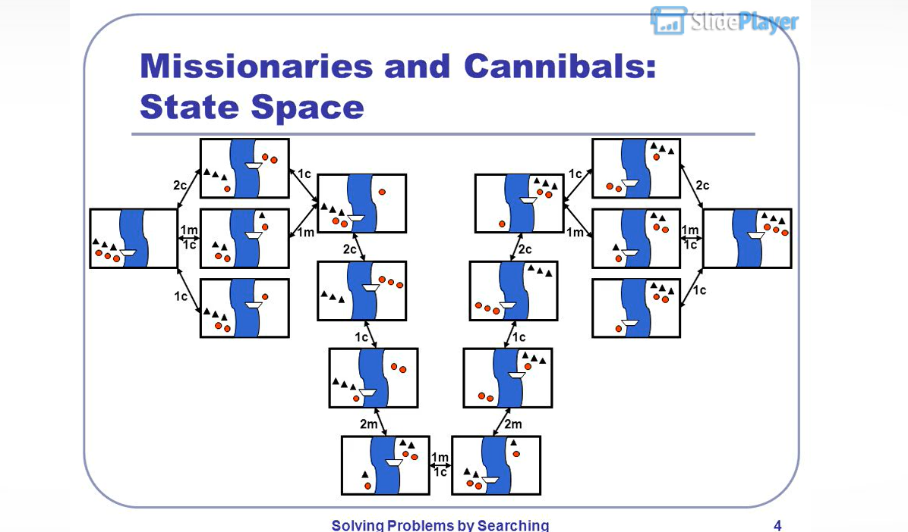

Slide 8
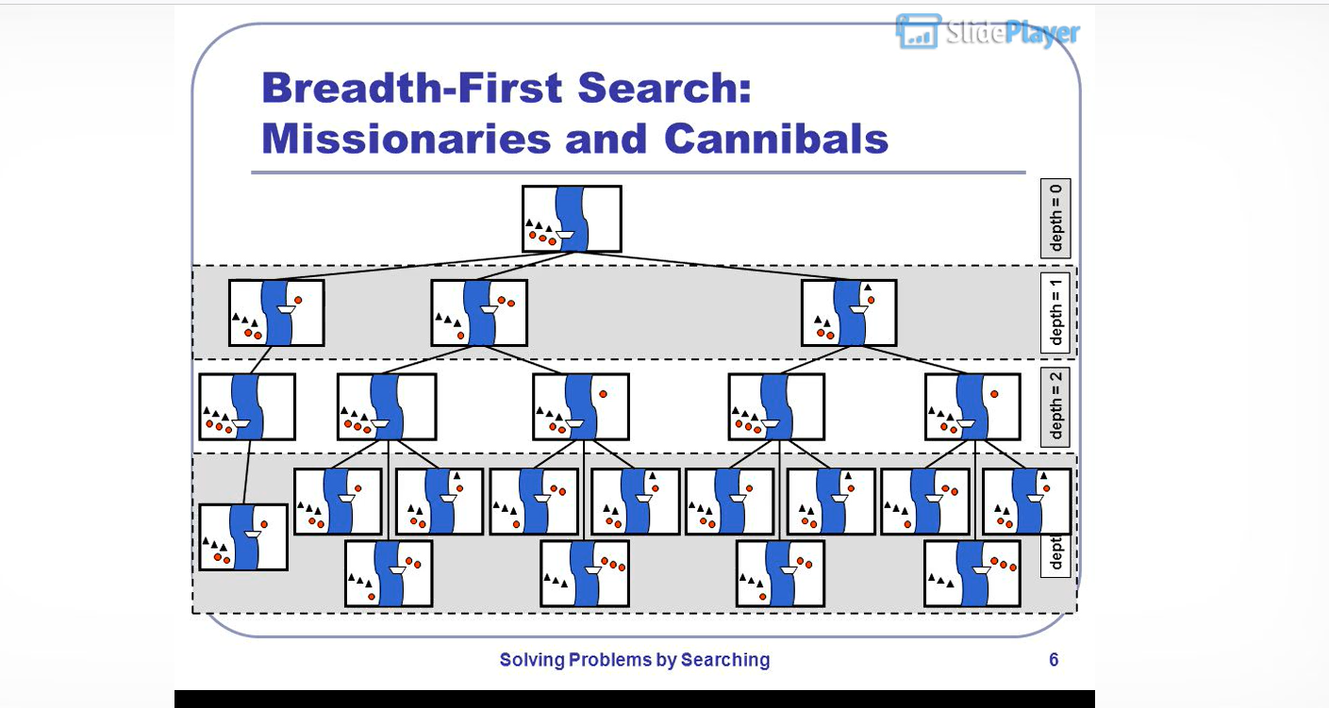

Slide 9
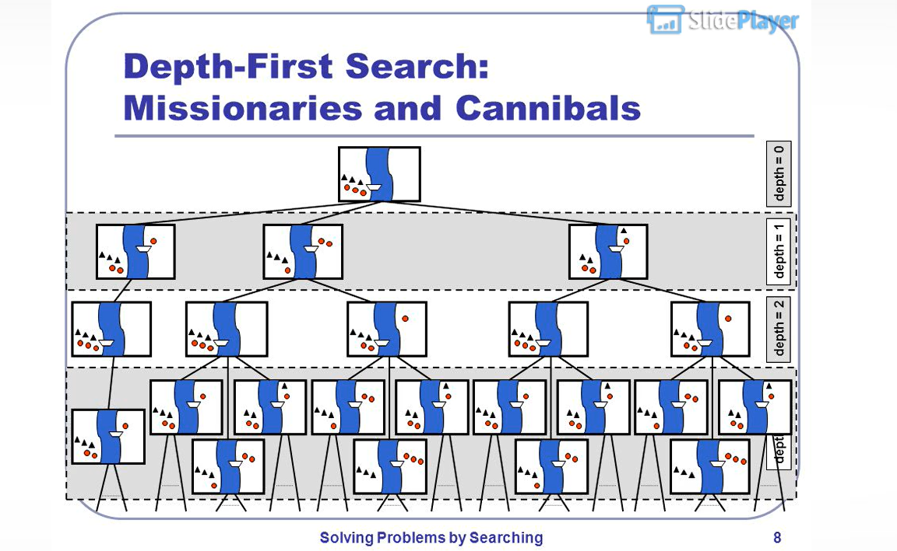

Slide 10
A
A
B
B
Initial Goal
STRIPS Language specification
Pre Post
Pickup(x) arm empty holding(x)
on(x, table)
clear(x)
Putdown(x) Holding(x) arm empty
on(x, table)
clear(x)
Stack(x,y) Holding(x) on(x,y)
clear(y) clear(x)
arm empty
4. Unstack(x,y) on(x,y) Holding(x)
clear(x) clear(y)
arm empty

Slide 11
Start state Goal state
on(A, table) on(A,B)
On(B, table)
arm empty
on(A,B)
x holding(A)
/ clear(B)
/ arm empty
/ on(A, table)
/ clear(A)
Stack(A,B)
Pickup(A)

